Slide 1

AI-Assisted EEG Screening for
Rapid and Informed Critical Care
TCS-Net · Methodology, Results & Comparative Analysis
Master's Project - Final Presentation
Gagandeep Singh
Spring 2026

Slide 2

Problem Statement
Develop an automated system to detect and classify seizures and other harmful brain activity patterns from EEG recordings of critically ill patients.
The challenges
How an automated tool helps
EEG review is manual and requires specialized neurologists
Experts genuinely disagree on borderline cases
Class imbalance
Soft target — must capture uncertainty, not force a single answer
Probabilities for all 6 patterns simultaneously
Faster insights → timely ICU intervention
Consistent results across reviewers and shifts
Honest uncertainty when experts genuinely disagree
R
RUTGERS
2

Slide 3
Our Approach: TCS-Net
Temporal Cross Spectrogram Network — raw EEG and dual spectrograms fused via cross-modal attention
Architectural Intuition
Most of the solution processes EEG and spectrograms independently and concatenates the features. None uses cross-modal attention. TCS-Net's hypothesis: letting the two modalities query each other improves discrimination on patterns that require correlating spatial EEG with frequency content (Spectrograms).
Cross-Modal Attention
Frequency Band Gate
Temperature Scaling
Bidirectional attention between raw-EEG temporal tokens and spectrogram patches
EEG context gates spectrogram features across delta / theta / alpha / beta — exploits known neuroscience.
Per-fold post-hoc calibration.
R
RUTGERS
3

Slide 4
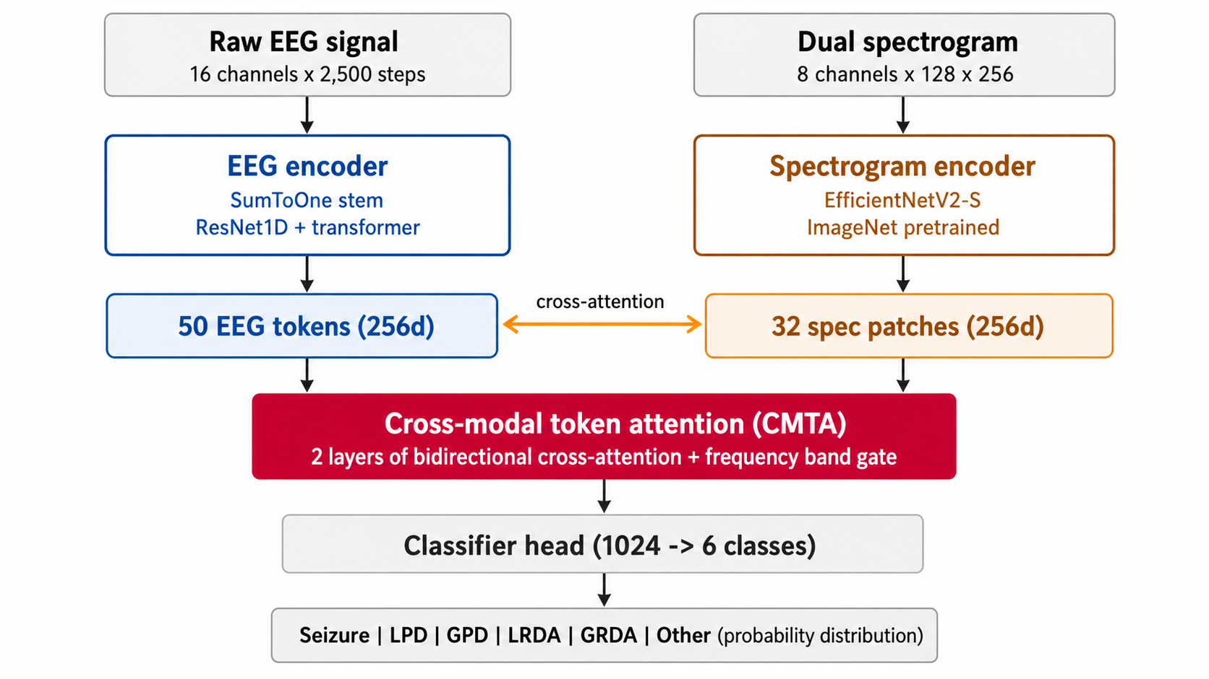
TCS-Net Architecture (29.6M parameters)
R
RUTGERS
4

Slide 5
Cross-Modal Token Attention: Step by Step
Like two detectives comparing notes during the investigation.
EEG temporal tokens · 50 total
1
Each encoder produces tokens
t=0-10s
t=10-20s
t=20-30s
t=30-40s
t=40-50s
EEG → 50 temporal tokens (~1s each); spec → 32 frequency-band patches.
2
EEG asks the spectrogram
Each EEG token: "what frequencies are active at my time position?"
3
Spectrogram asks the EEG
Each spec patch: "what waveform shape produces this frequency?"
delta
theta
alpha
beta
gamma
4
Repeat for 2 layers
Spectrogram frequency-band patches · 32 total
EEG → Spec
Spec → EEG
Round 2 refines because both sides now have partial cross-modal context.
Line thickness = attention weight · highlighted box = querying token
R
RUTGERS
5

Slide 6
Dataset
Harvard Medical School / Massachusetts General Hospital — public via Kaggle here (HMS, 2024)
Patients
Unique EEGs
Labeled segments
1,950
17,089
106,800
broad age, near-balanced sex
200 Hz, 19 electrodes
expert-annotated
Six classes — multi-expert vote distribution (~12 experts per recording)
Seizure | 20,933 | LPD — Lateralized Periodic Discharges | 14,856
GPD — Generalized Periodic Discharges | 16,702 | LRDA — Lateralized Rhythmic Delta | 16,640
GRDA — Generalized Rhythmic Delta | 18,861 | Other | 18,808
Bimodal annotation quality: 1–7 votes (noisy) or ≥10 votes (reliable, used as HQ subset)
R
RUTGERS
6

Slide 7
Benchmarks: VIPEEGNet & EfficientNetB0
Two contrasting baselines, both re-trained on our shared 5-fold patient splits
VIPEEGNet · ~13M params
EfficientNetB0 · ~5M params
npj Digital Medicine, 2025
spectrogram-only baseline
Raw EEG · 16 ch × 10,000 steps
Spectrogram only · 8 ch × 128 × 256
SumToOne Conv1D → pseudo-image
EfficientNetB0 backbone (ImageNet pretrained)
EfficientNetV2-B3 backbone
Global avg pool → 6-class head
Global pool → 6-class head
4-epoch training
OOF KLD: 0.227
OOF KLD: 0.673
R
RUTGERS
7

Slide 8
Result: KLD on Shared HQ Subset
Lower is better · 5,939 high-quality EEG-IDs (HQ = ≥10 expert votes) · raw softmax outputs across all models
Reading the headline
VIPEEGNet wins, and it wins reliably, its number doesn't change much across different patients.
TCS-Net is meaningfully behind. The gap is big enough that we'd see it on any patient sample. Best amongst 5-folds produces KLD of 0.338.
EfficientNetB0 is both worse and inconsistent on some folds it nearly doubles its own score on others, which is a red flag for clinical deployment regardless of the average.
KLD doesn't tell you what kinds of mistakes each model makes — and that's where the real story is.
R
RUTGERS
8

Slide 9
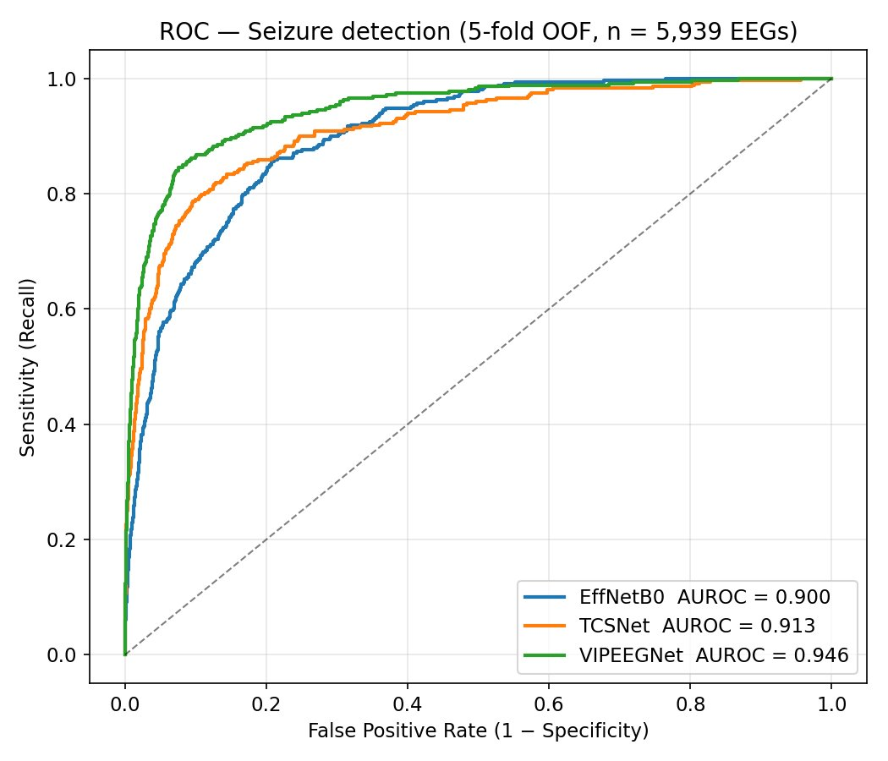
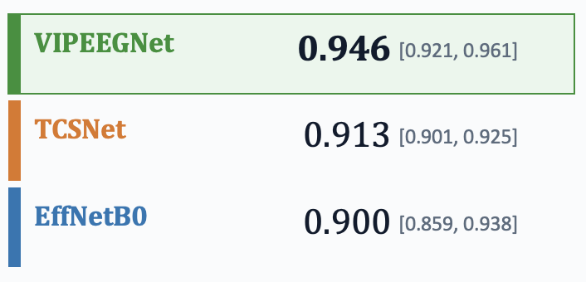
AUROC with statistical evidence
What AUROC Answers?
If I randomly pick one real seizure and one non-seizure, what's the chance the model scores the seizure higher?
Per-Modal AUROC (With 95% CI)
R
RUTGERS
9

Slide 10
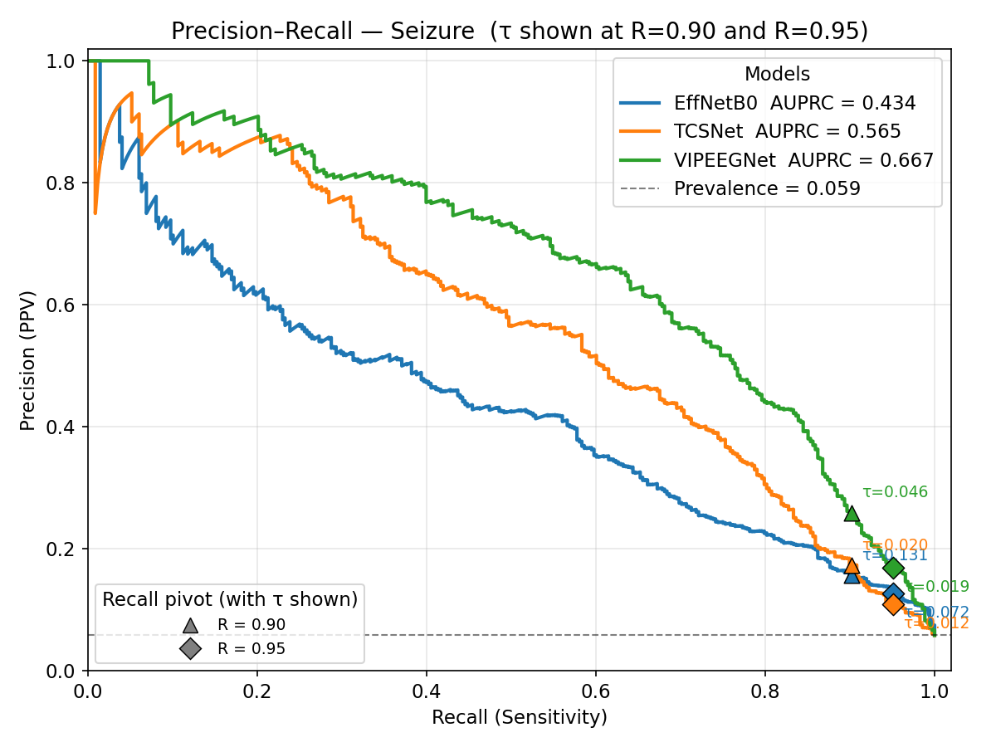
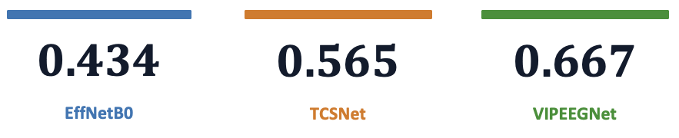
AUPRC reveals the precision gap AUROC dilutes
Why the gap looks bigger here than on the ROC?
ROC averages over all False Positive(FP) rates, including high-FP regions where the curves crowd into the top-right corner. Precision-recall lives in the regime where false alarms actually hurt, and that's where the differences open up.
Dashed line = positive prevalence floor (0.059). Every model is well above floor; the ranking gap is real.
R
RUTGERS
10

Slide 11
Operating Point Cost
Recall | Model | τ | Sens | Spec | Precision | FN | FP | NNR
0.90 | EffNetB0 | 0.131 | 0.902 | 0.698 | 0.157 | 34 | 1,687 | 6.4
 | TCSNet | 0.021 | 0.902 | 0.732 | 0.173 | 34 | 1,501 | 5.8
 | VIPEEGNet | 0.046 | 0.902 | 0.840 | 0.260 | 34 | 896 | 3.9
0.95 | EffNetB0 | 0.072 | 0.951 | 0.595 | 0.128 | 17 | 2,263 | 7.8
 | TCSNet | 0.012 | 0.951 | 0.522 | 0.110 | 17 | 2,675 | 9.1
 | VIPEEGNet | 0.019 | 0.951 | 0.710 | 0.170 | 17 | 1,619 | 5.9
0.99 | EffNetB0 | 0.035 | 0.991 | 0.464 | 0.103 | 3 | 2,998 | 9.7
 | TCSNet | 0.006 | 0.991 | 0.194 | 0.071 | 3 | 4,505 | 14.1
 | VIPEEGNet | 0.003 | 0.991 | 0.315 | 0.083 | 3 | 3,828 | 12.1
At Recall 0.95: VIPEEGNet flags 1,619 false alarms vs 2,263 (EffNetB0) and 2,675 (TCSNet): every model misses 17 of 348 seizures.
At Recall 0.99: EffNetB0 wins: 2,998 FP vs 3,828 (VIP) and 4,505 (TCS). Its hardest seizures are scored less catastrophically low than VIPEEGNet's.
R
RUTGERS
11

Slide 12
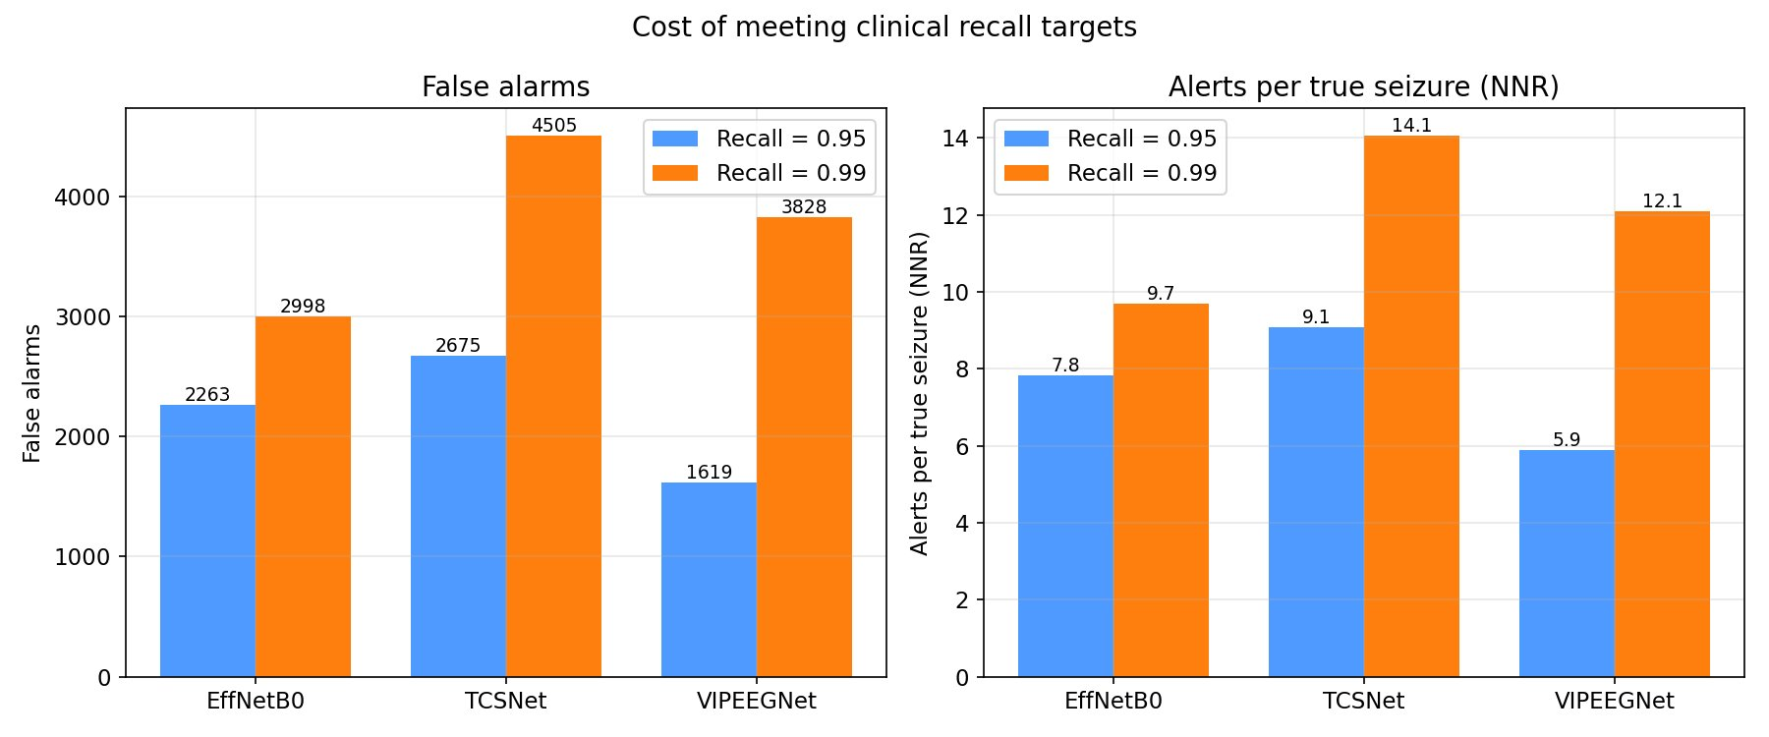
Recall VS Alert Burden
FA Increase, R 0.95 -> 0.99. :
EffNetB0 +735 (+32 %) TCSNet +1,830 (+68 %) VIPEEGNet +2,209 (+136 %)
Going from 95 % to 99 % recall is not a free 4 % - it almost doubles the alert burden for every model.
R
RUTGERS
12

Slide 13
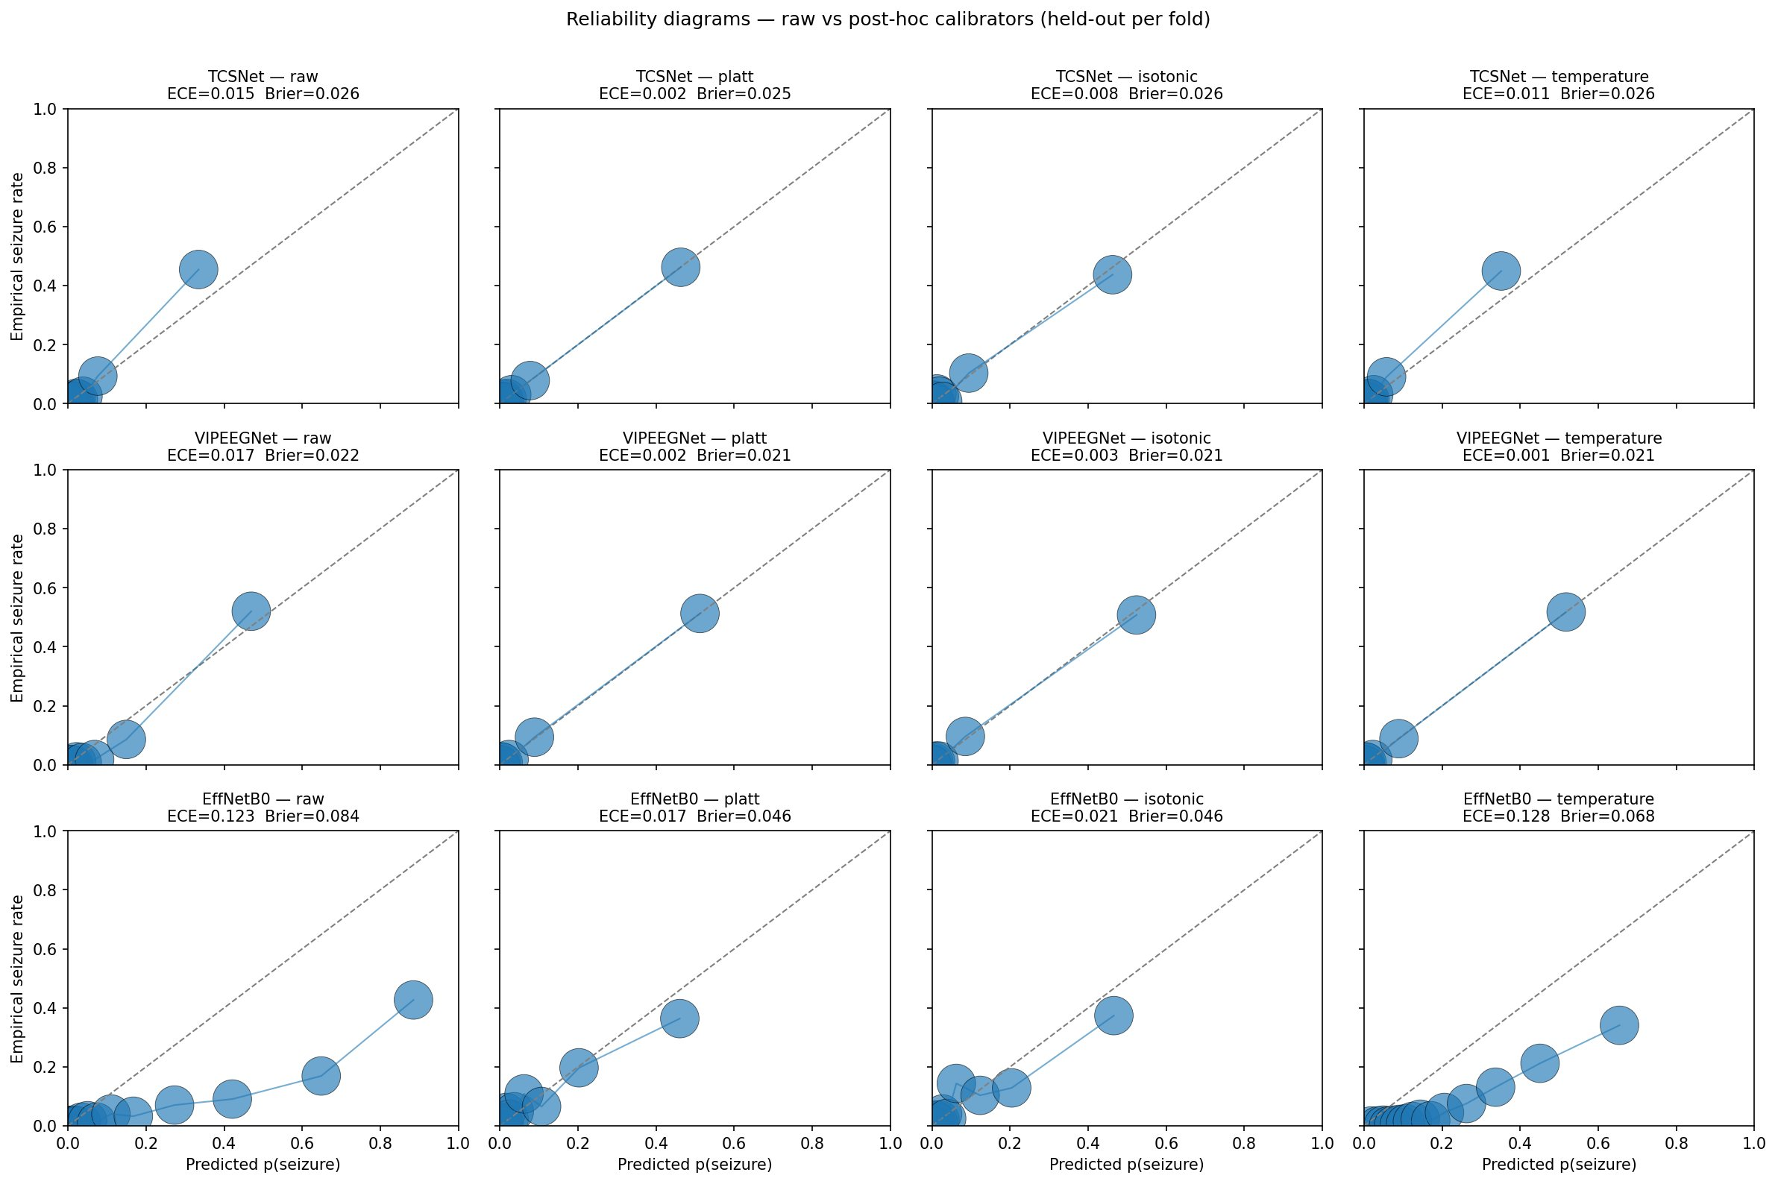
Calibration: Are the probabilities trustworthy?
Insight
TCSNet and VIPEEGNet are already well-calibrated raw, their probabilities can be trusted as-is, and post-hoc calibration adds little. EffNetB0 is severely miscalibrated raw (ECE 0.123) due to a curved, non-uniform overconfidence pattern. Platt scaling fixes it (ECE 0.017, a 7.2× reduction); temperature scaling does not (ECE 0.128) because a single scalar cannot reshape a curve.
R
RUTGERS
13

Slide 14
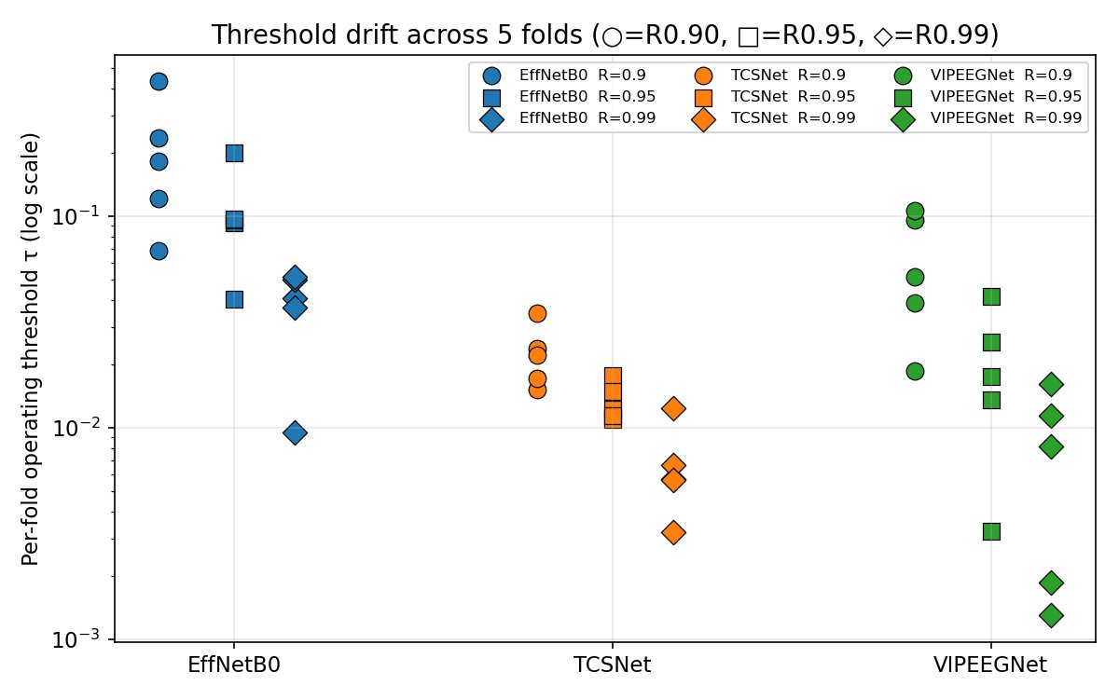
The Stability Pillar
Model | mean ± std | min | max | max / min
EffNetB0 | 0.105 ± 0.058 | 0.041 | 0.199 | 4.9×
TCSNet | 0.013 ± 0.003 | 0.011 | 0.018 | 1.6×
VIPEEGNet | 0.020 ± 0.014 | 0.003 | 0.042 | 12.9×
TCSNet wins on stability. Its R = 0.95 threshold barely moves fold-to-fold, a 1.6× spread is the closest thing to "calibrate once, ship" in this cohort.
VIPEEGNet has the strongest population AUC but the worst drift. Its score distribution shifts fold-to-fold even when the ranking is good, a fixed central τ would over- or under-fire by 13× depending on the cohort.
EffNetB0 sits in the middle (4.9×). Manageable with light per-cohort recalibration.
Per-fold τ on log scale. Tighter clusters = more stable across cohorts.
R
RUTGERS
14

Slide 15
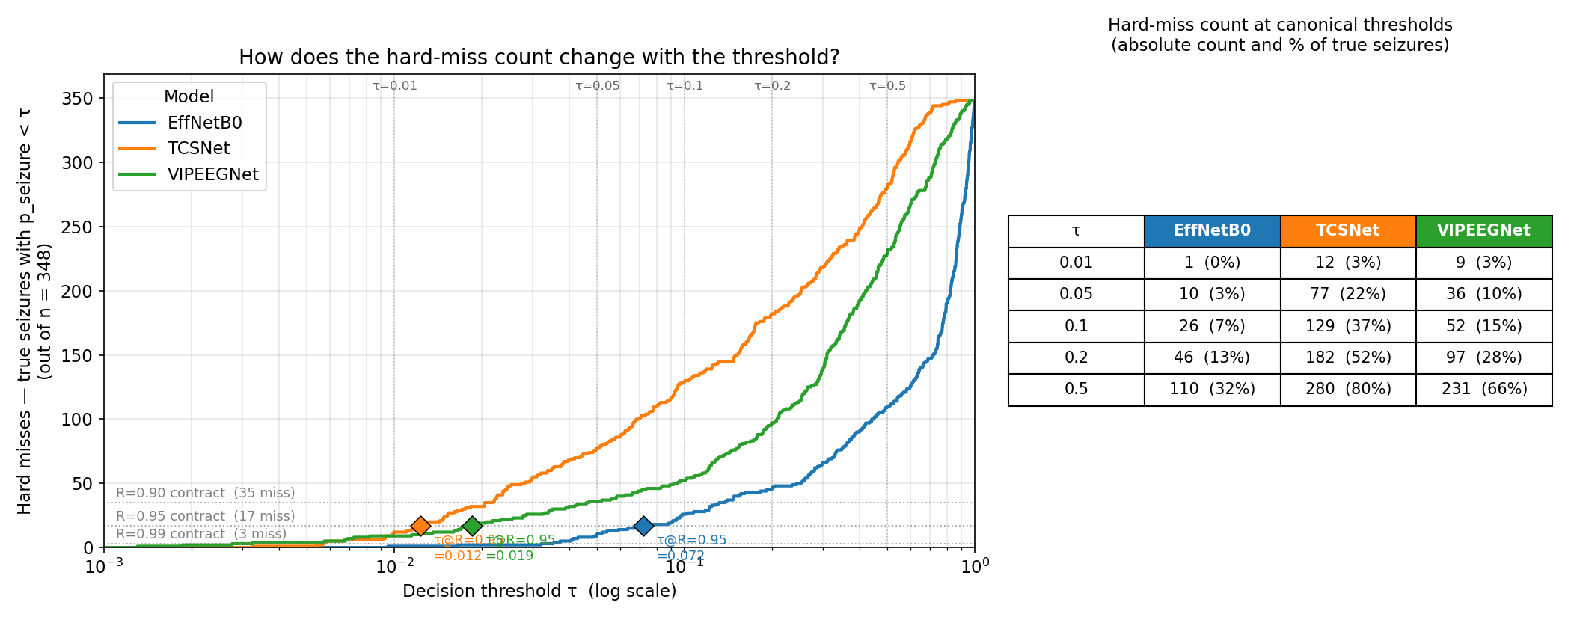
Hard misses by threshold: True seizures the model failed to flag
A hard miss is a true seizure the model scored BELOW the decision threshold τ, a real seizure that went unflagged.
TCS-Net performed worst amongst all the three modal here, followed by VipeegNet.
R
RUTGERS
15

Slide 16
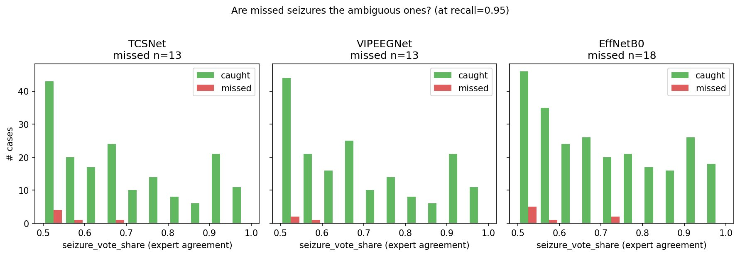
Performance on ambiguous cases
This is a reassuring failure pattern, clean seizures are caught reliably; difficult, ambiguous ones are missed with the experts' own uncertainty as a covariate. The models are not failing arbitrarily; they are tracking the underlying difficulty of the label distribution. A clinical AI failing on cases experts could not agree on is a fundamentally different (and more acceptable) failure than one missing clear seizures.
R
RUTGERS
16

Slide 17
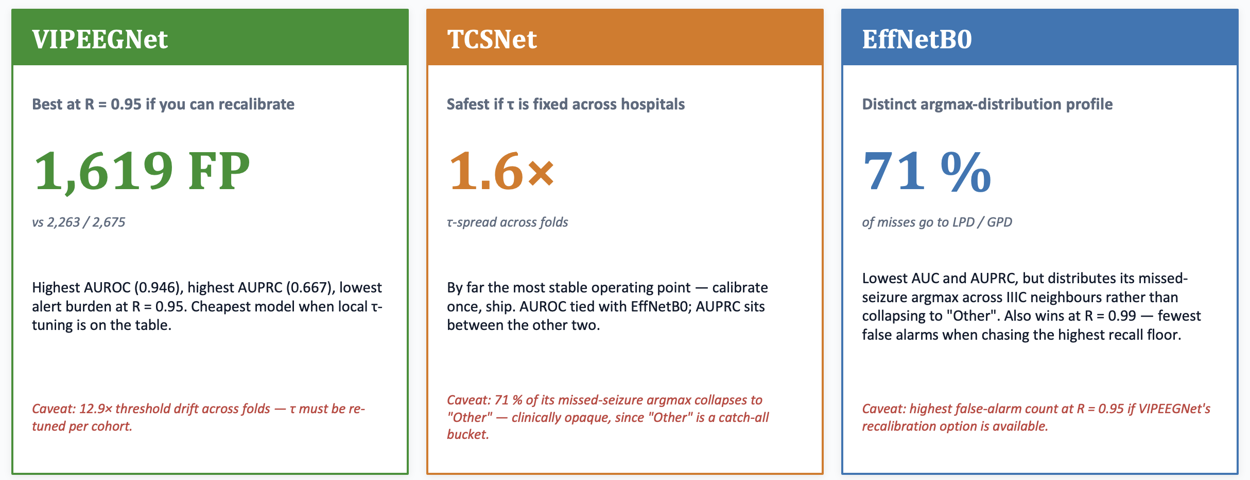
Verdict
Each model wins a different deployment scenario. The decision is not technical — it is institutional.
R
RUTGERS
17

Slide 18
Thank you
Questions and discussion
Gagandeep Singh · Master's Project · Spring 2026

